Slide 1
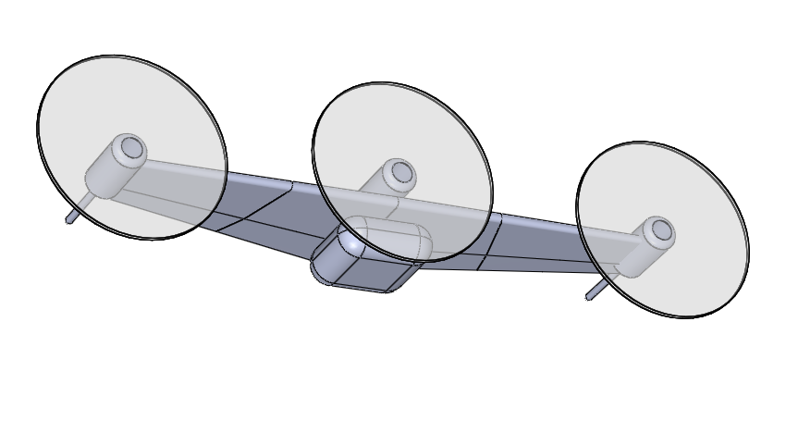
Payload Bay
Wing Hinge Line

